Slide 1
Slide seminar
Américo Delgado Brilhante
DASA São Paulo

Slide 2
Declaração de Conflito de Interesse
Dr(a). Américo Delgado Brilhante afirma não ter conflito de interesse a declarar
Exigência da RDC Nº 96/08 da ANVISA

Slide 3
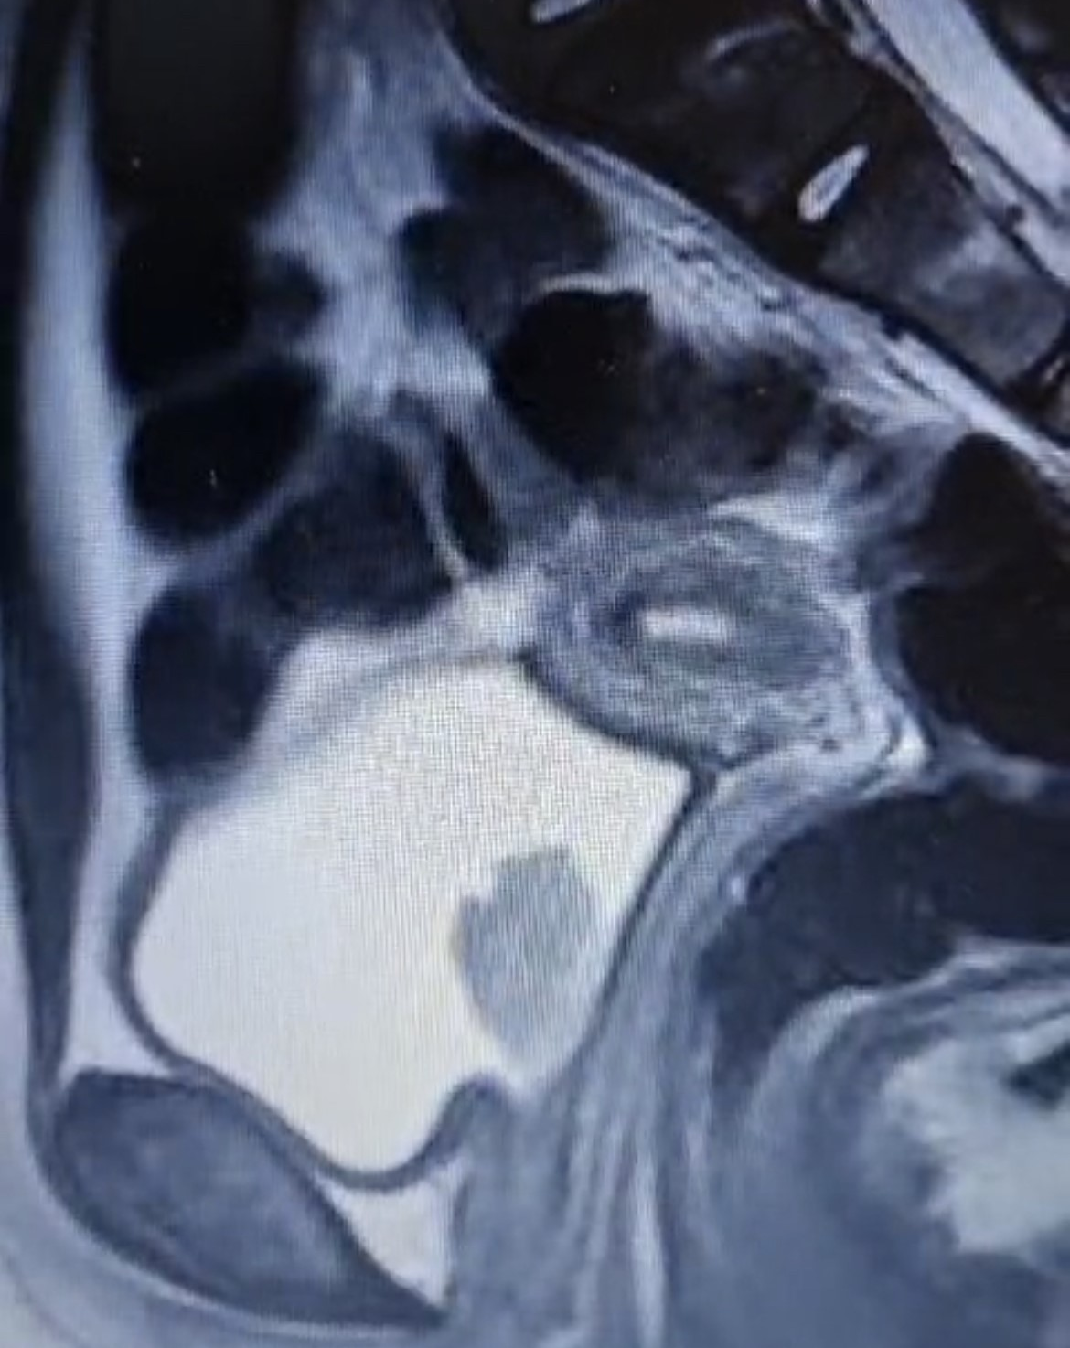
Clinical informations
Female, 10 years old
Hematuria
MRI: polypoid lesion in trigone / posterior bladder wall, measuring 3.2 cm Cystoscopic biopsy was performed

Slide 4
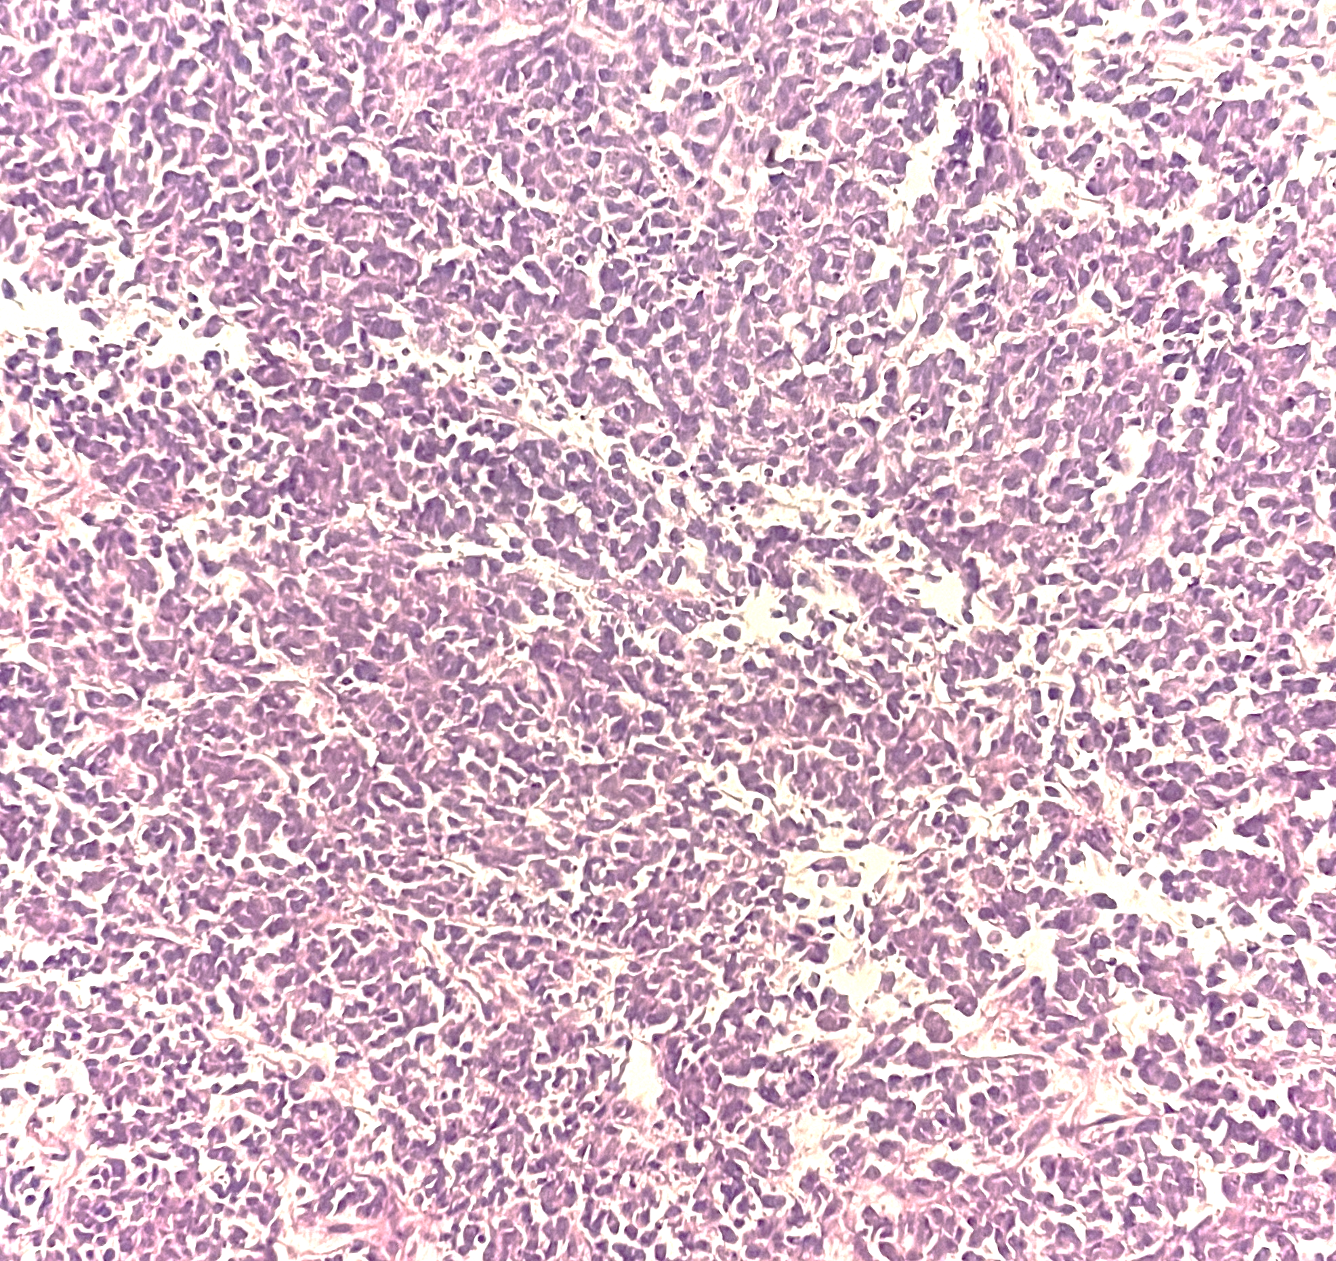
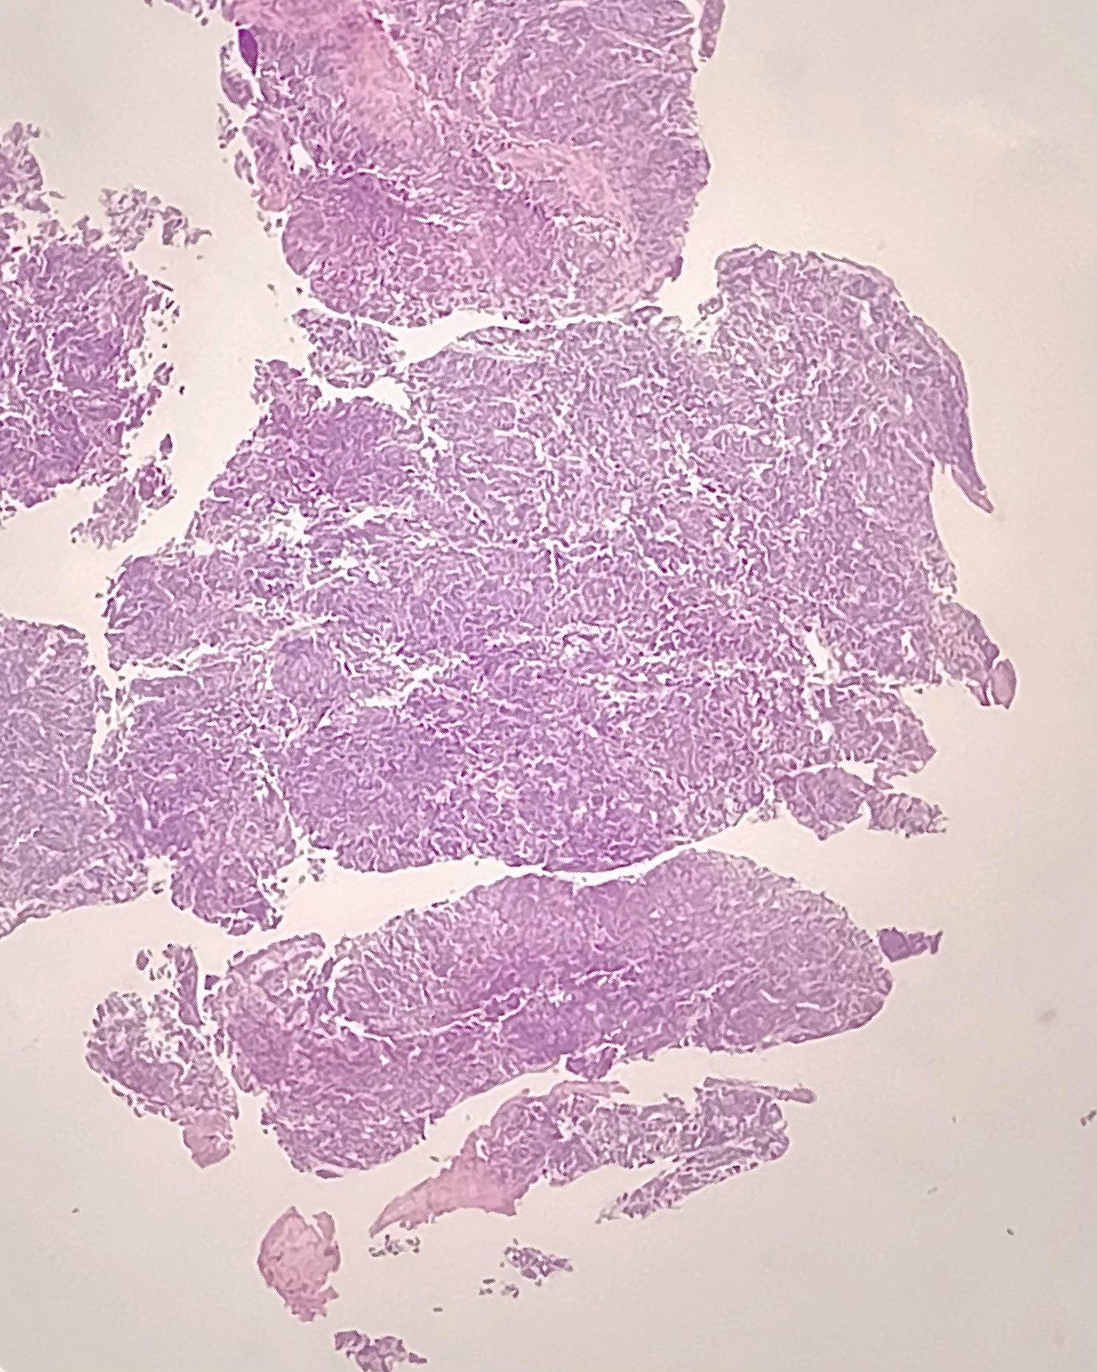

Slide 5
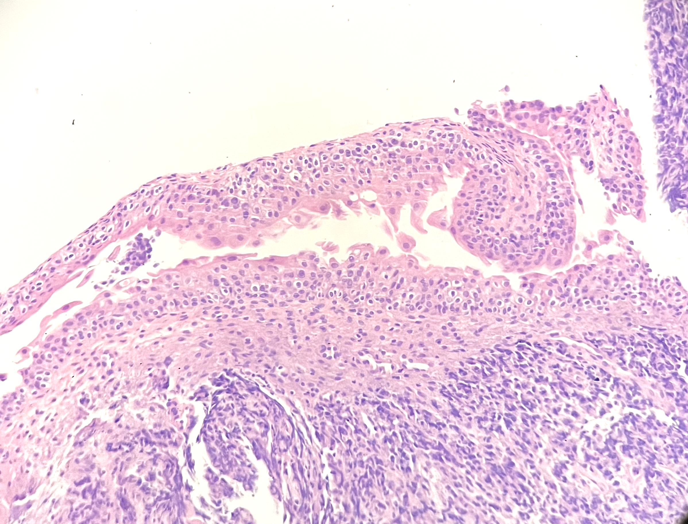

Slide 6
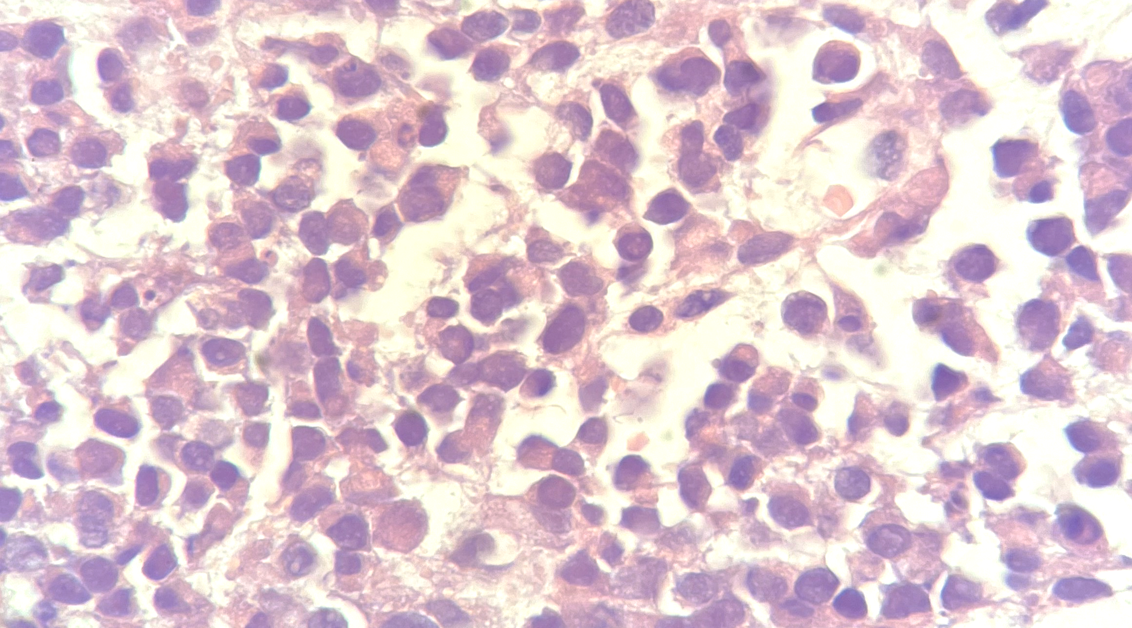
1000x (imersion oil)

Slide 7
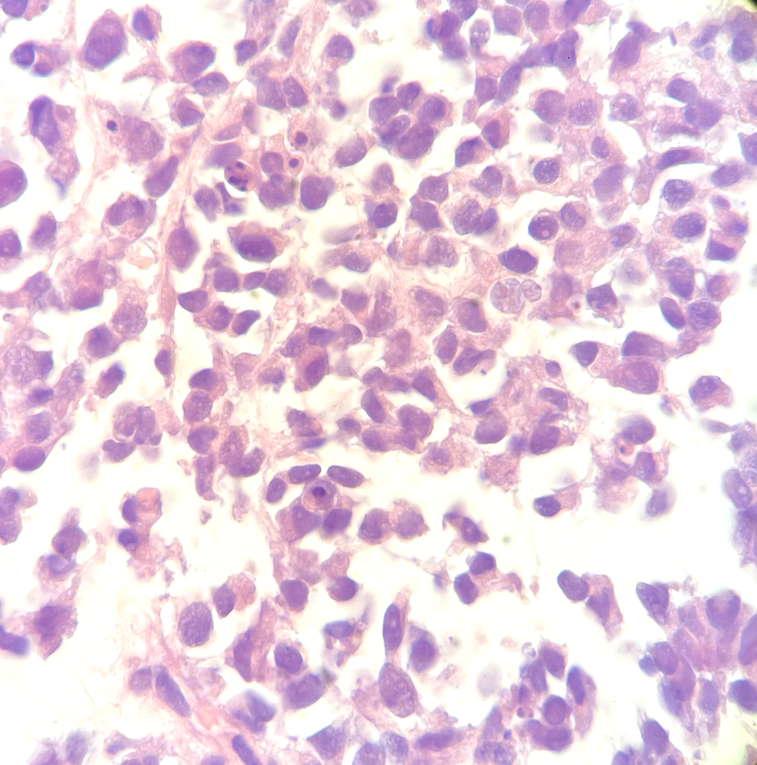
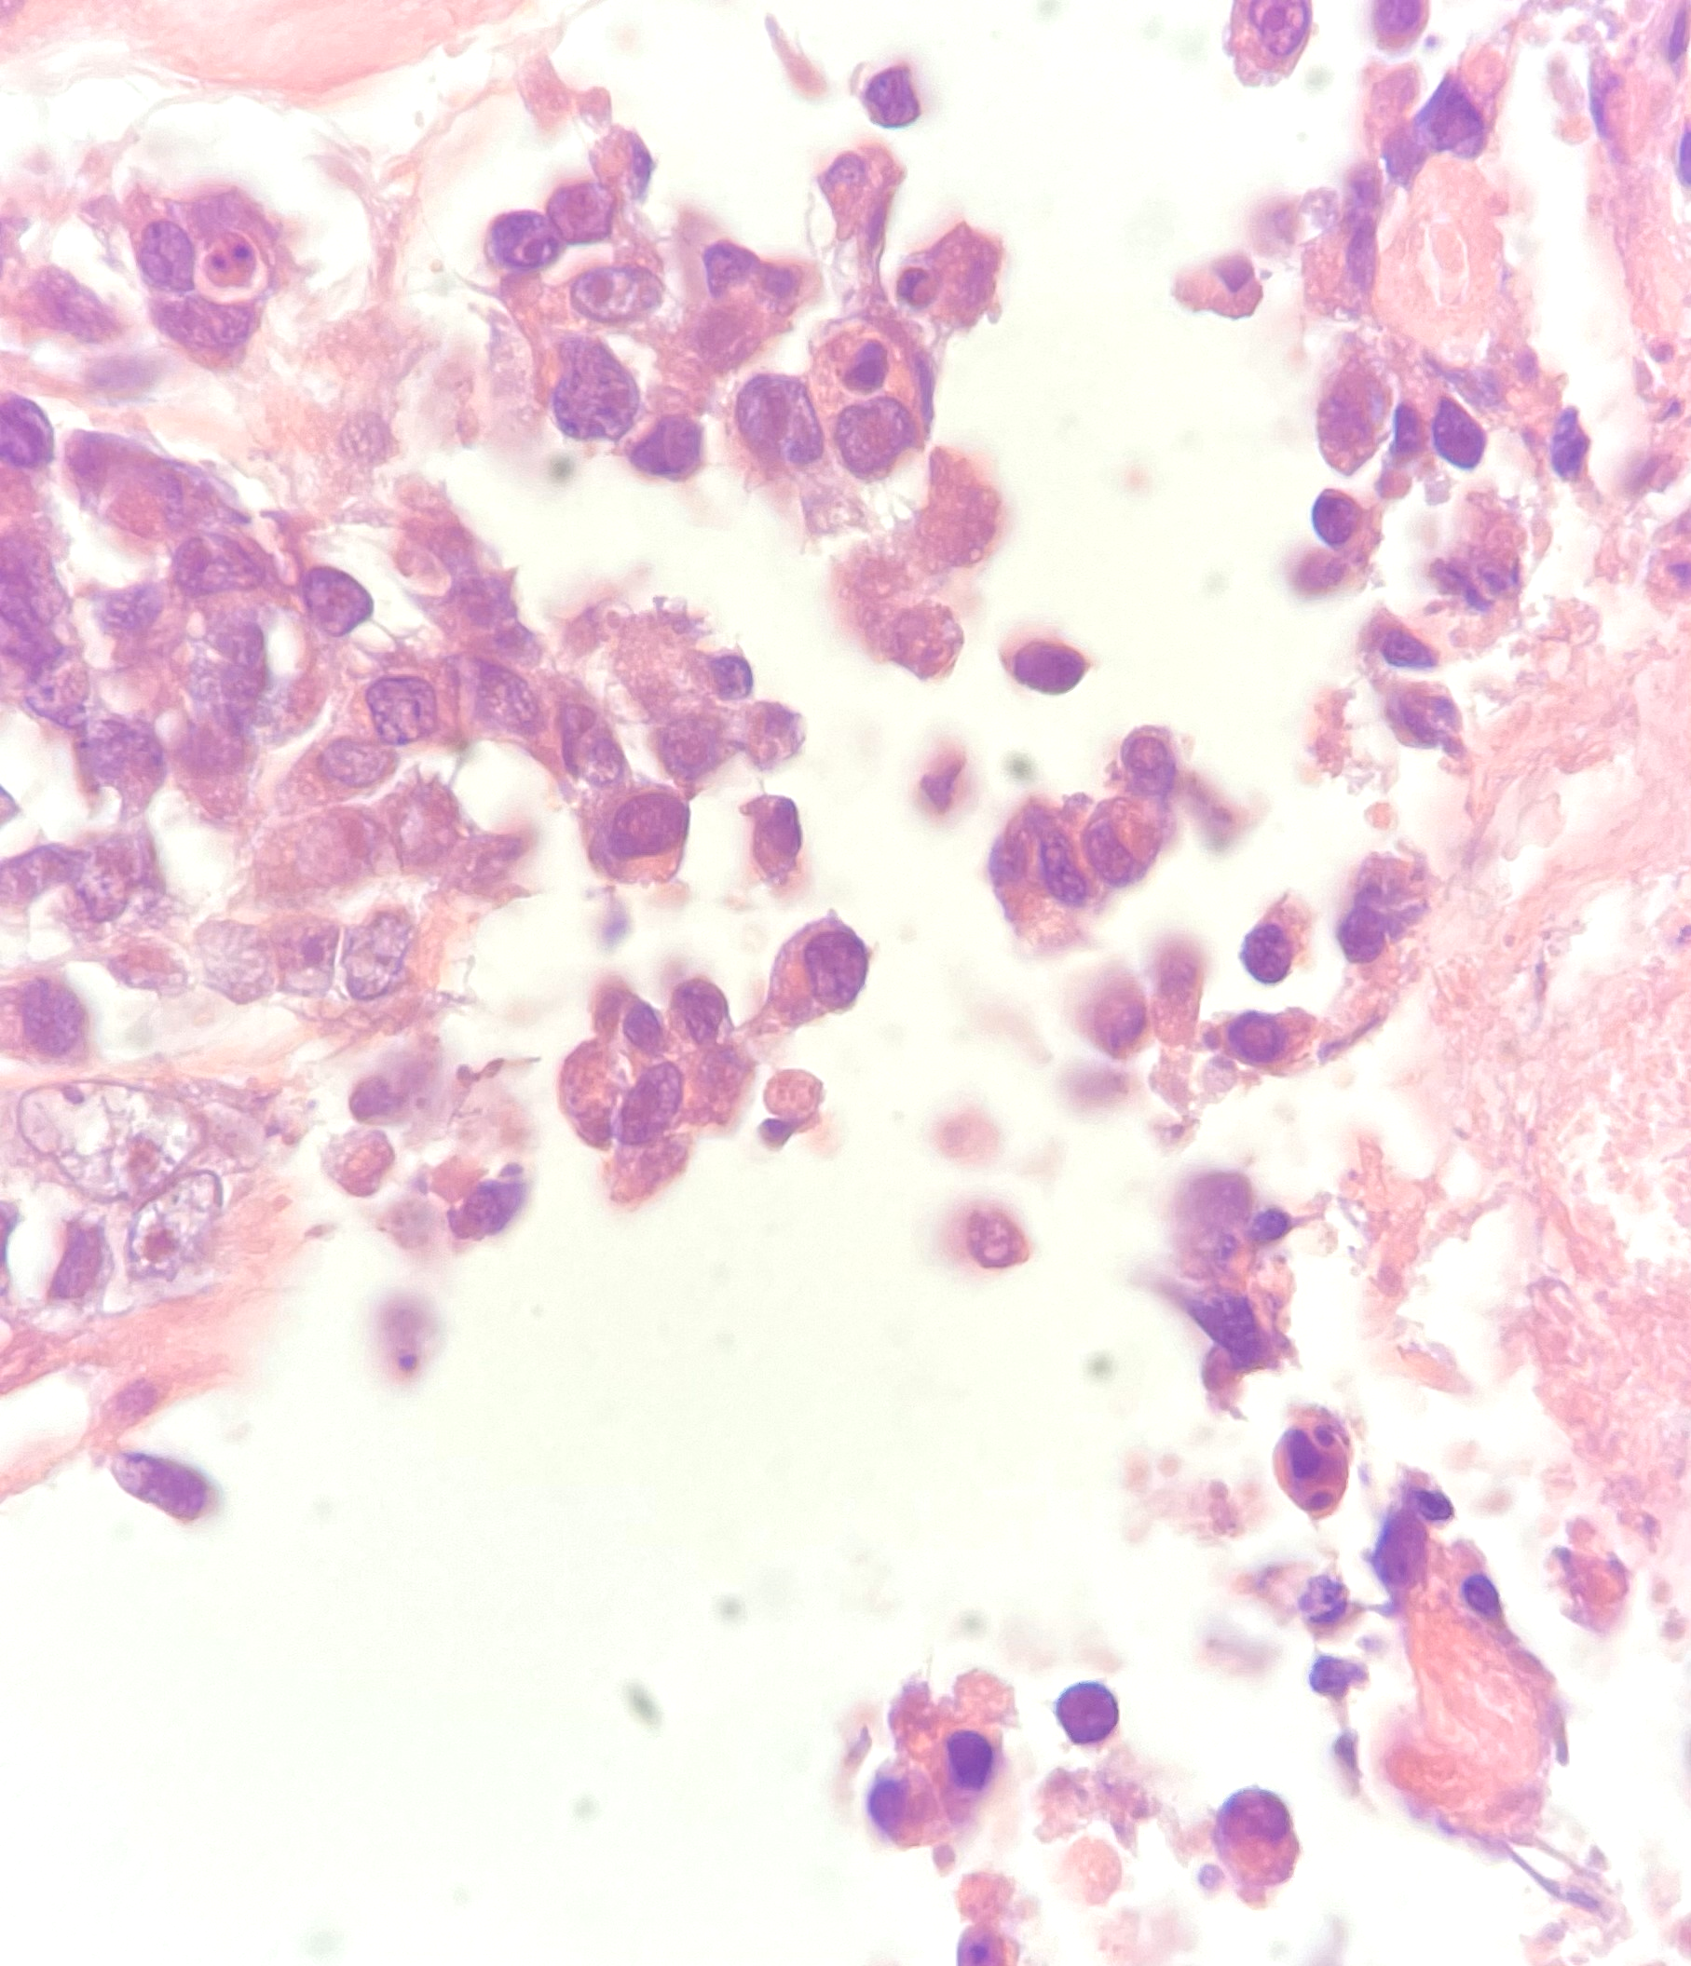
1000x (imersion oil)

Slide 8
DIAGNOSIS?
Embryonal rhabdomyosarcoma (Botryoid)?
Alveolar rhabdomyosarcoma?
Desmoplastic small round cell tumor?
Ewing sarcoma?
Epithelial tumor?
Haematolymphoid tumor?

Slide 9
Immunohistochemistry
Antibody | Result
DESMIN | negative
MIOGENIN | negative
MYO D1 | negative
ALK-1 | negative
AE1AE3 | negative
CD34 | negative
S100 | negative

Slide 10
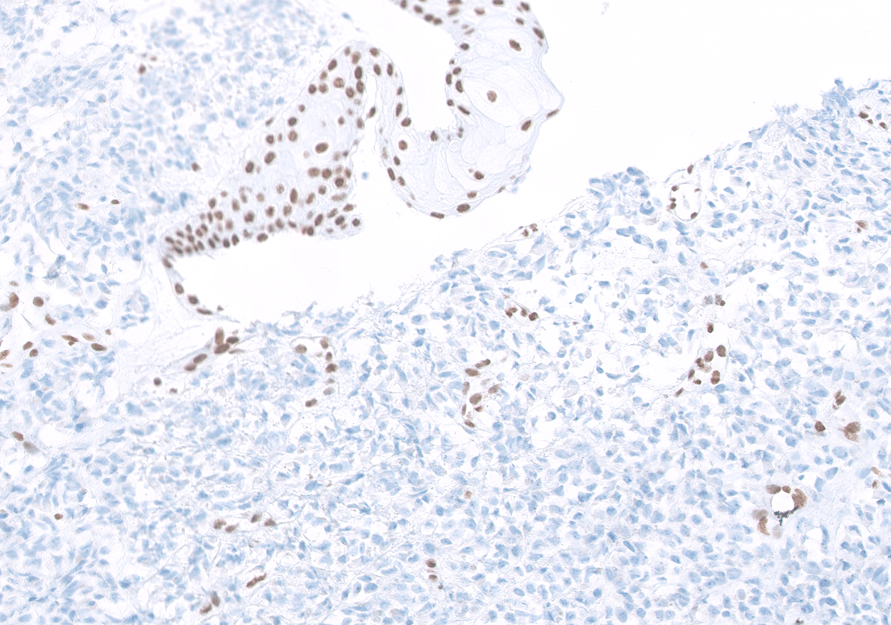
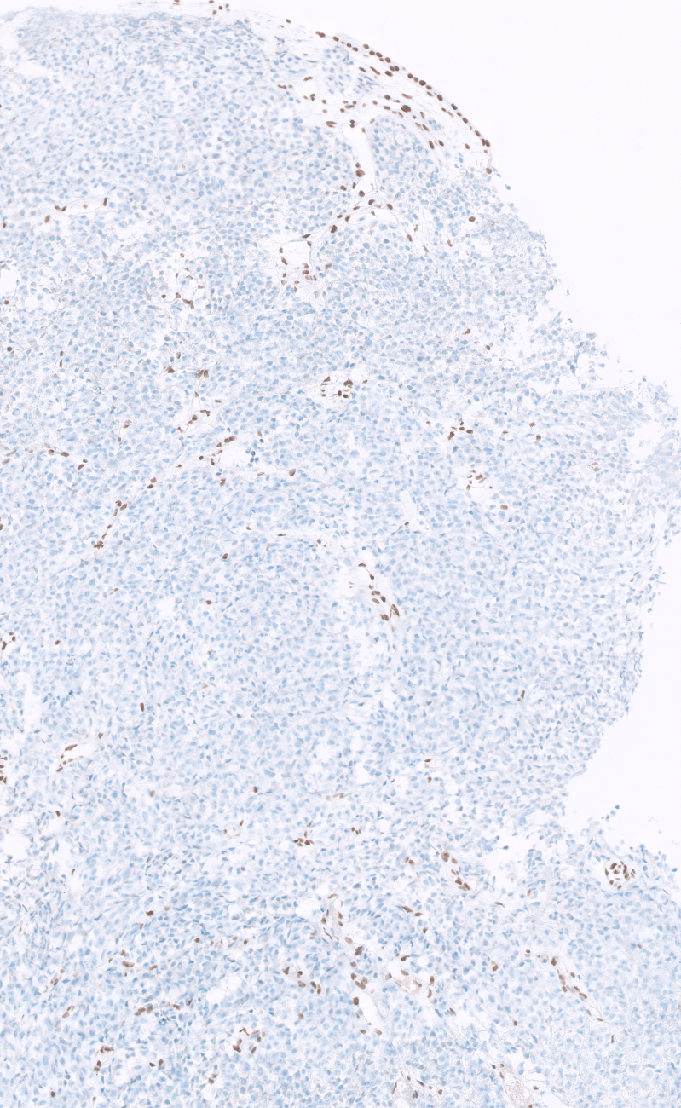
INI1 (SMARCB1) loss

Slide 11
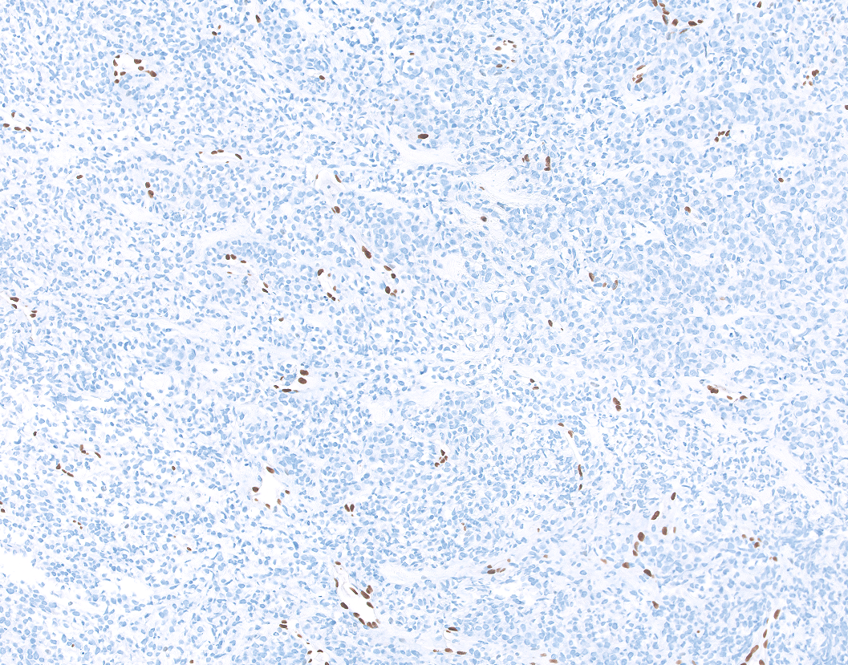
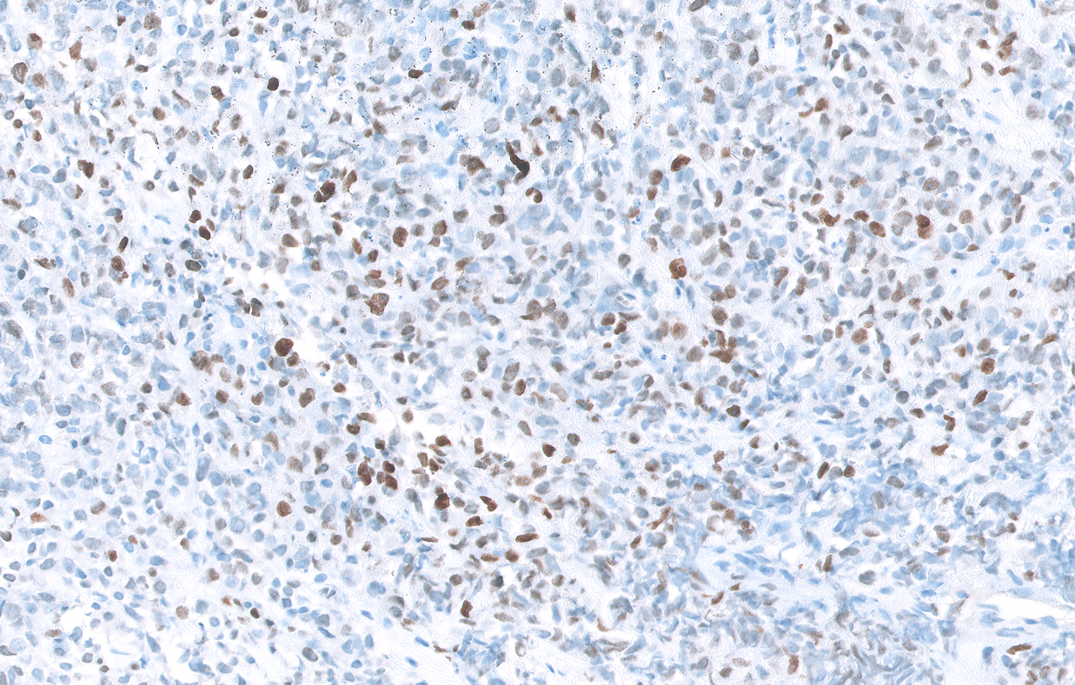
ERG negative
SALL4 positive

Slide 12
Diagnosis:
Antibody | Result
DESMIN | negative
MIOGENIN | negative
MYO D1 | negative
AE1AE3 | negative
CD34 | negative
S100 | negative
ALK-1 | negative
INI1 | loss
ERG | negative
SALL4 | positive
Malignant rhabdoid tumour (Extrarenal rhabdoid tumour)

Slide 13
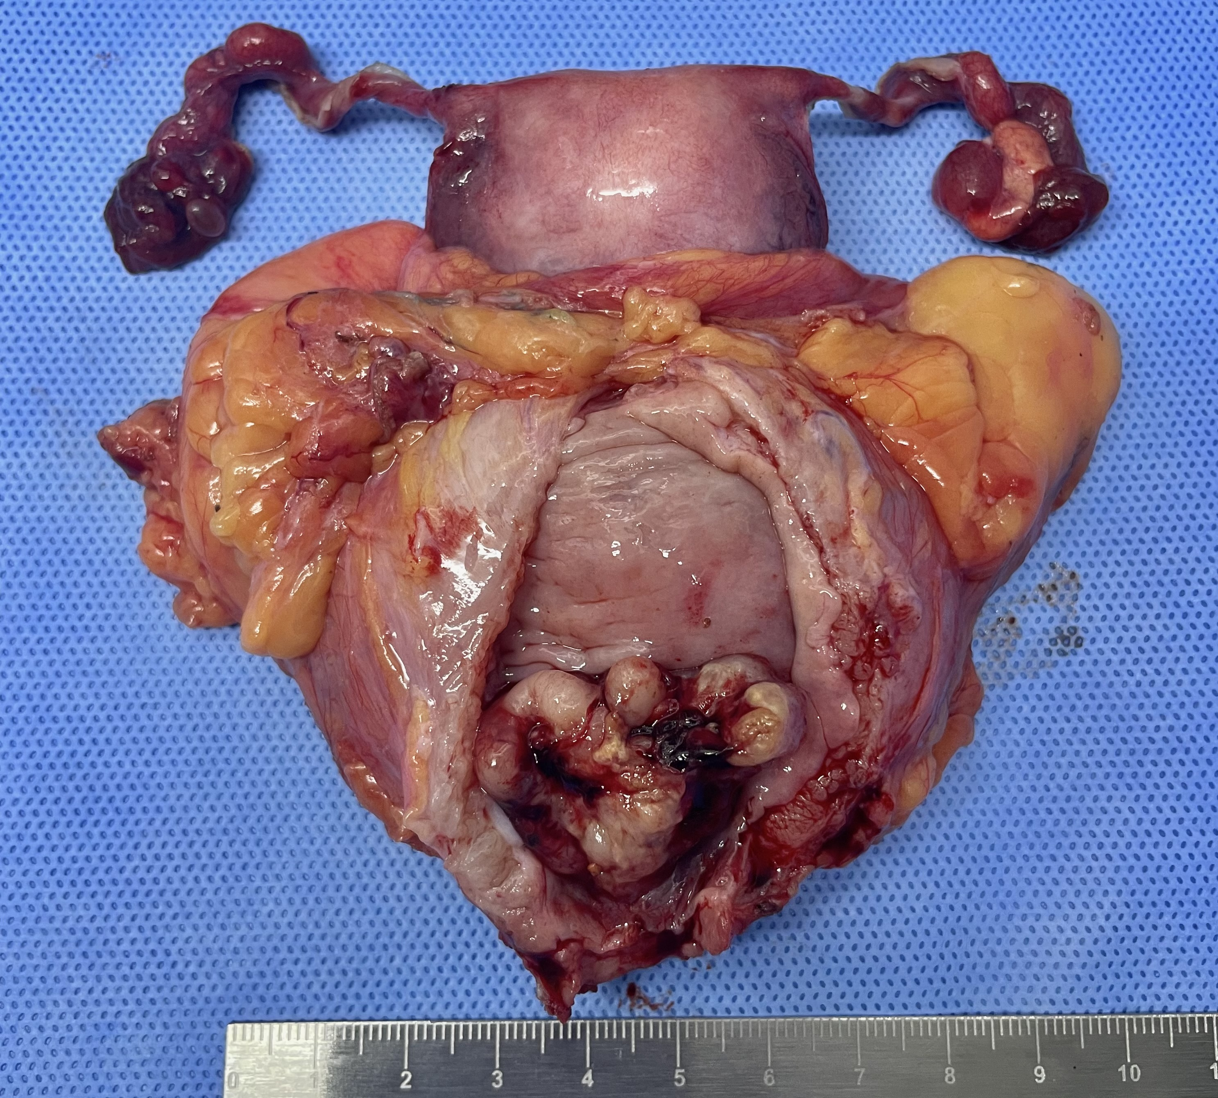
Macroscopy Anterior view

Slide 14
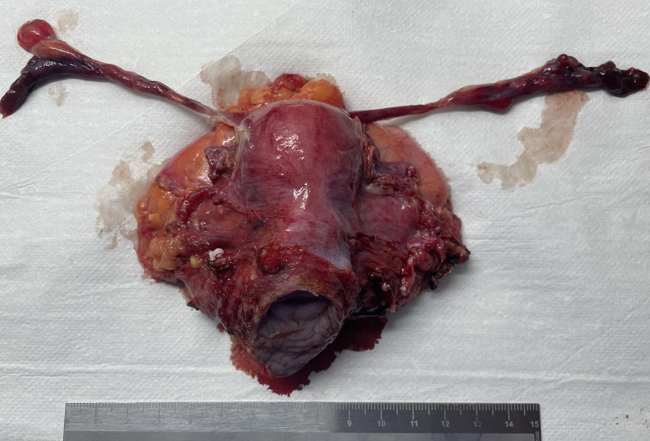
Macroscopy Posterior view

Slide 15
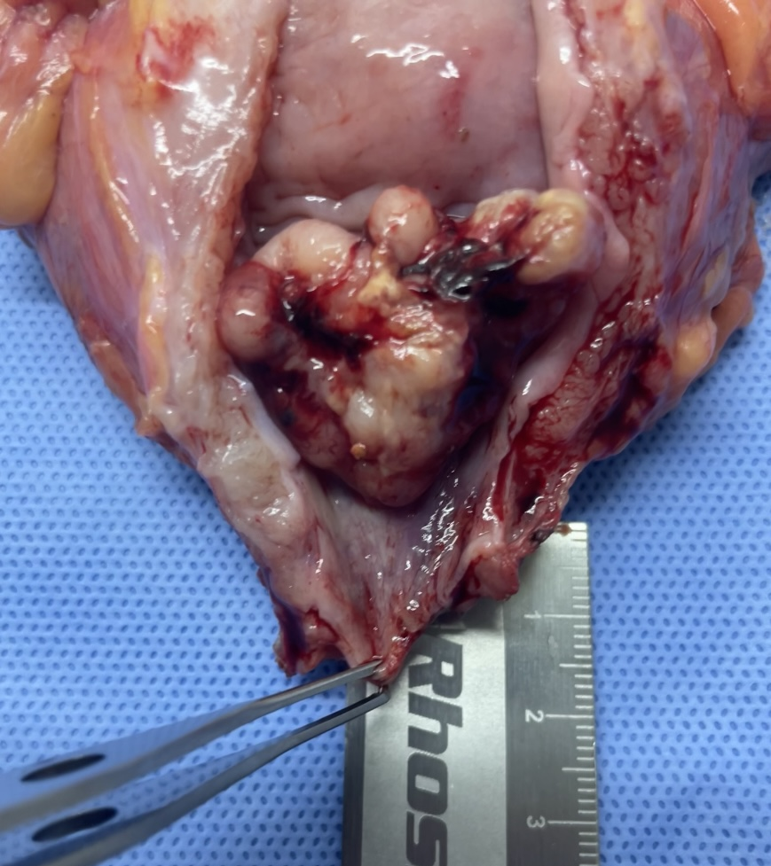
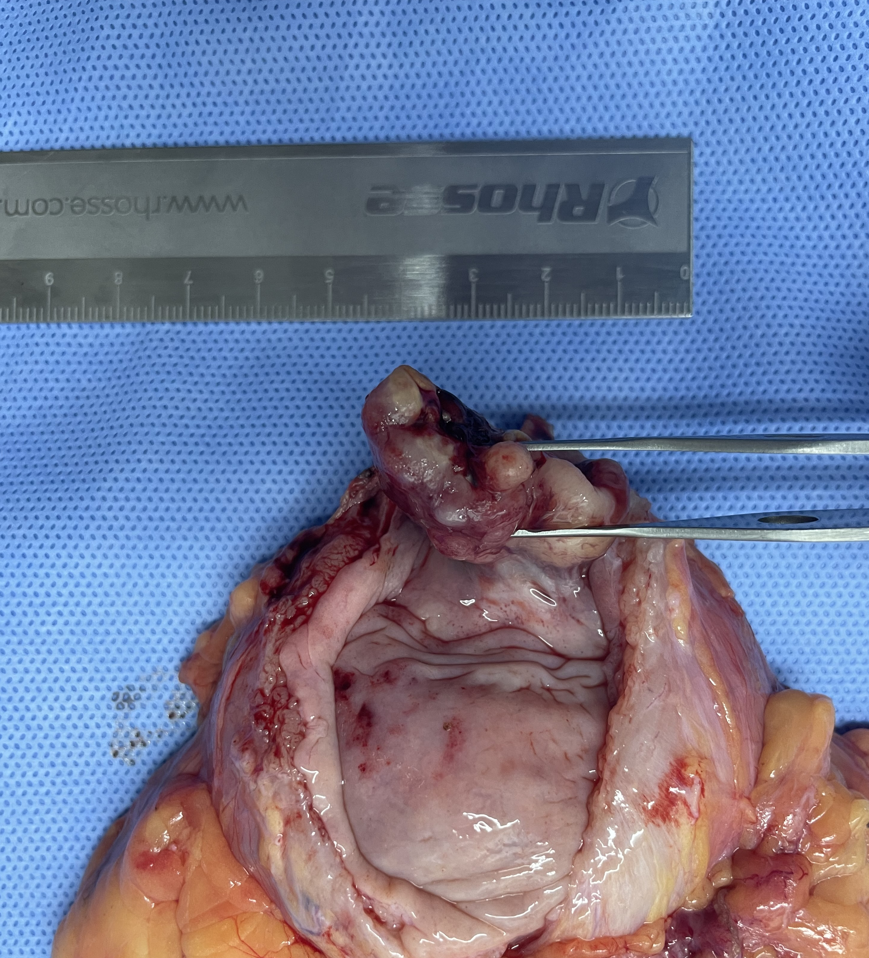
Anterior view

Slide 16
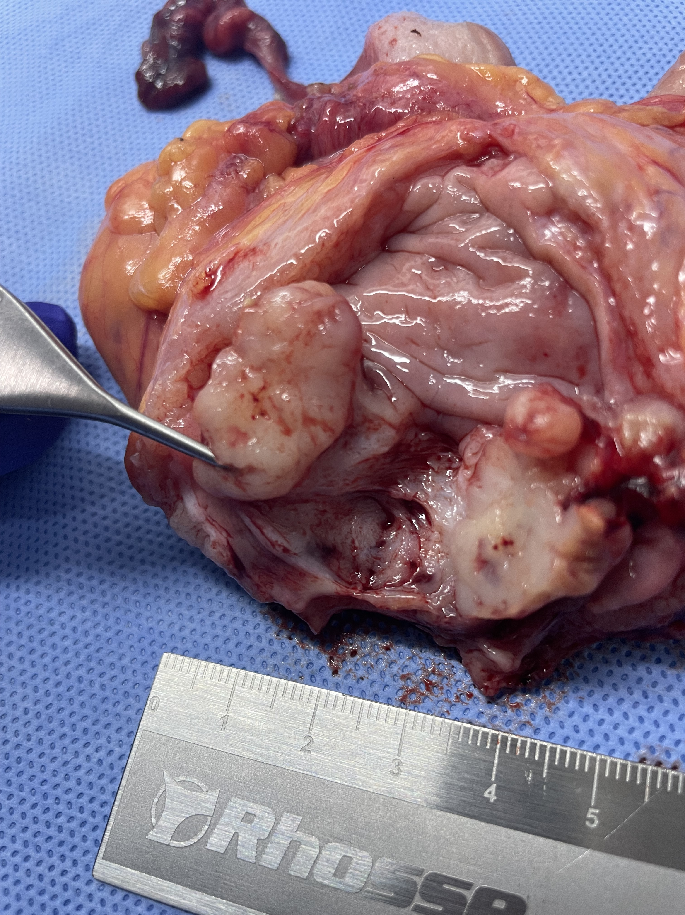
Macroscopy Cutting surface and depth of invasion

Slide 17
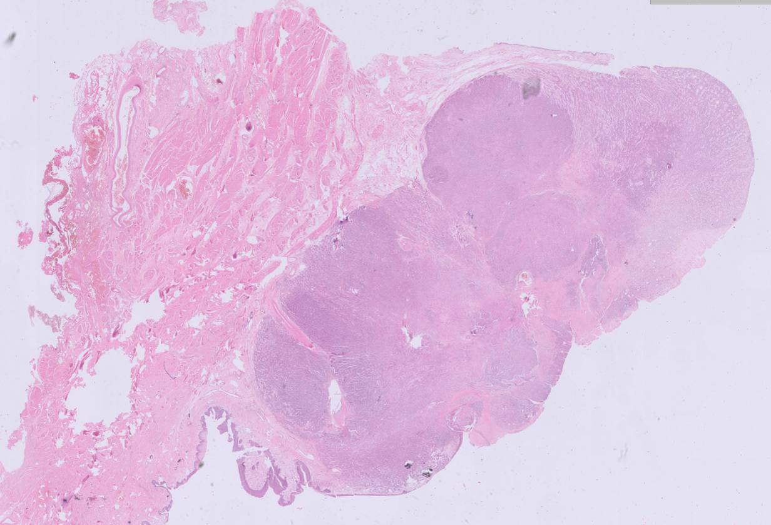

Slide 18
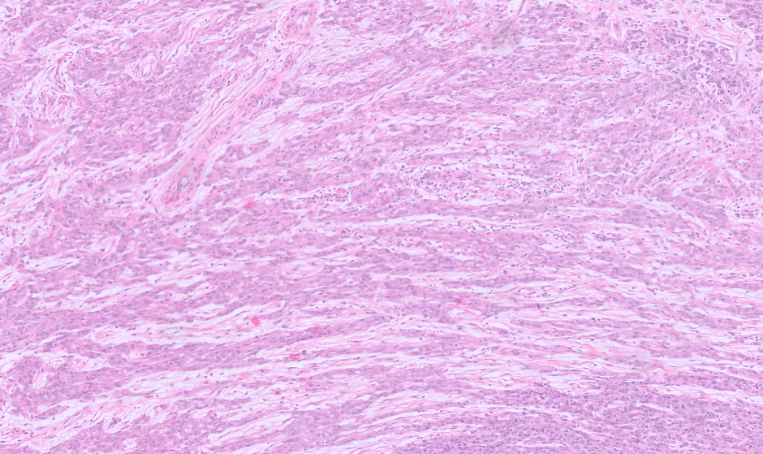

Slide 19
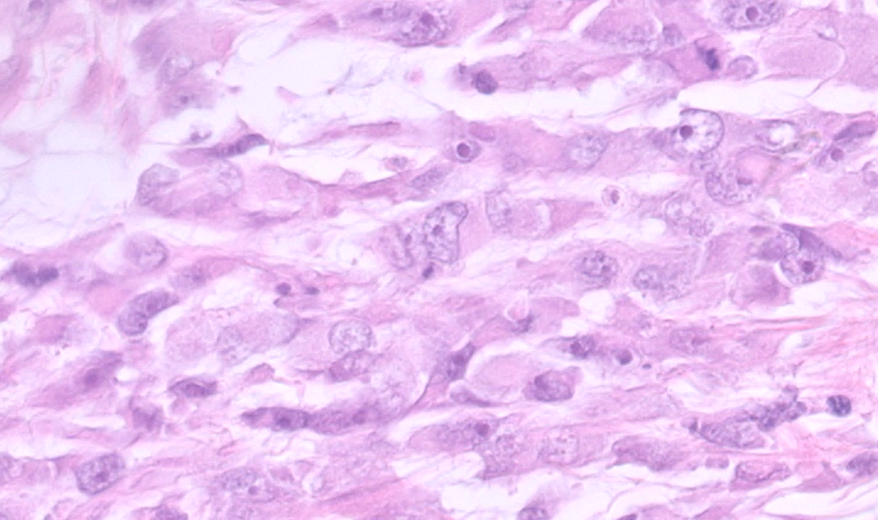
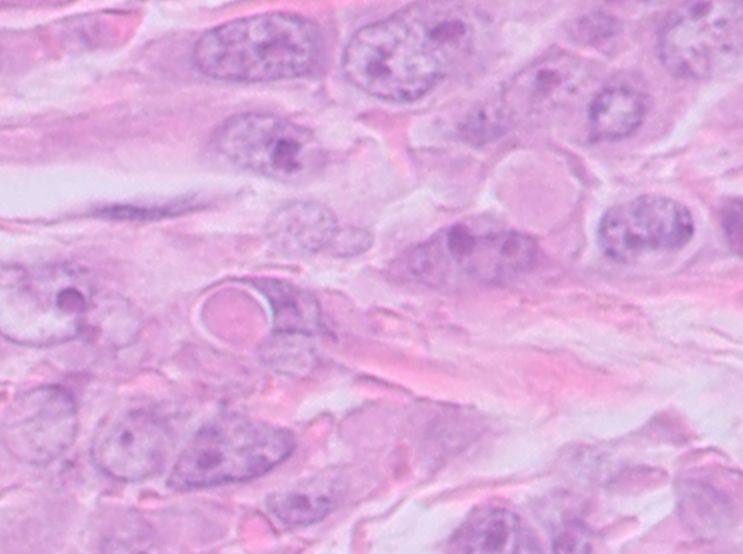
Juxtanuclear eosinophilic hyaline inclusions

Slide 20
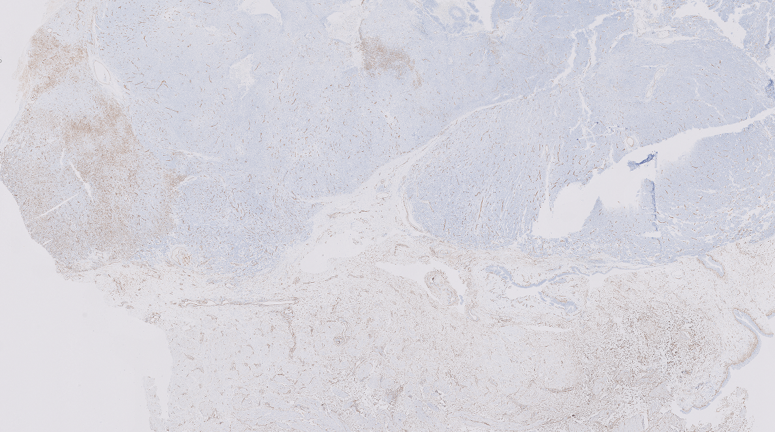
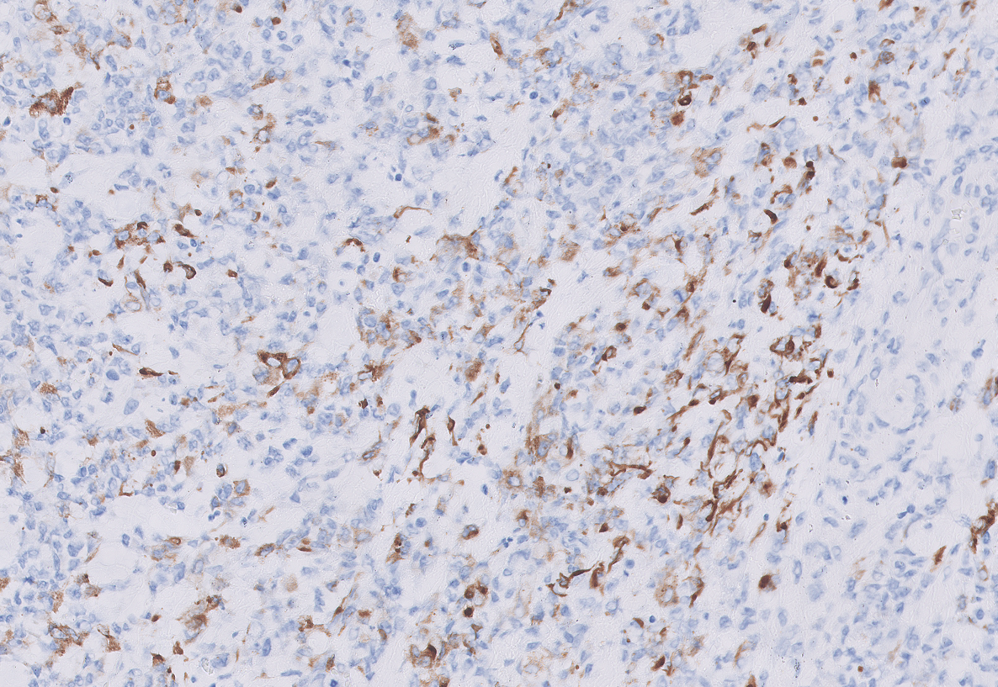
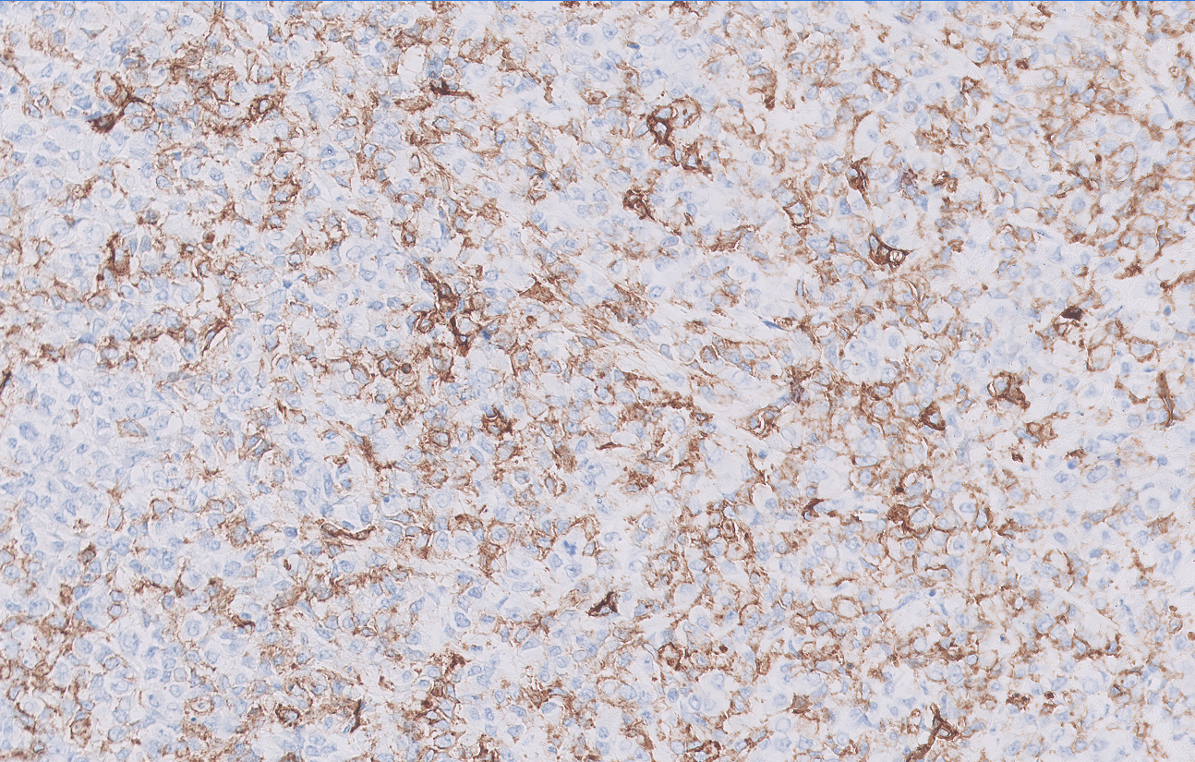
Immunohistochemistry
CD34 focal
AE1AE3 focal

Slide 21
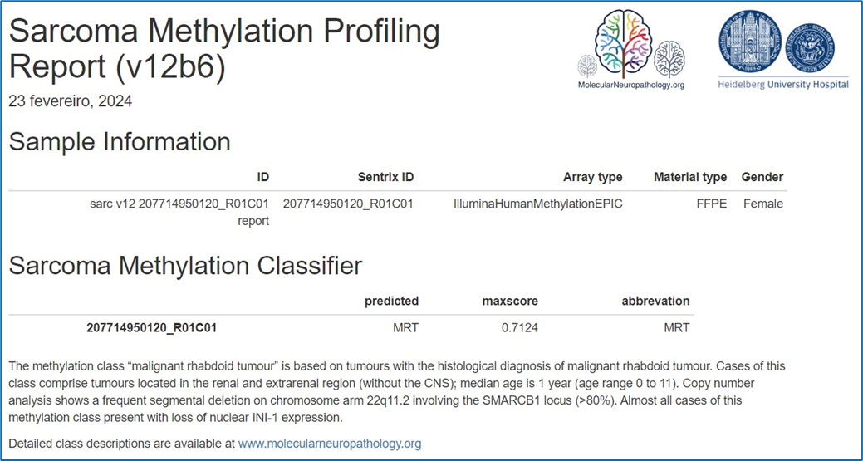
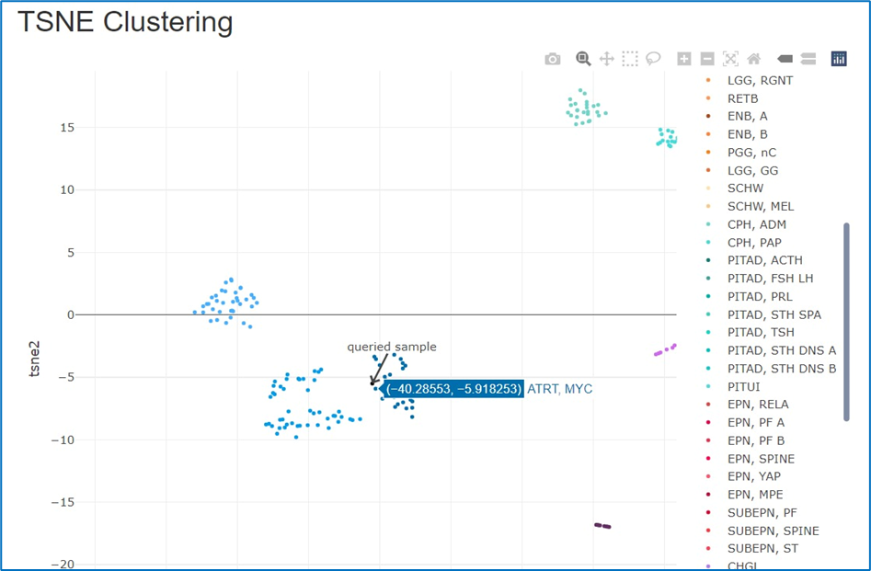
DNA Methylation profiling
Sarcoma classifier
CNS Cohort

Slide 22
Malignant rhabdoid tumour (Extrarenal rhabdoid tumour)
Definition (WHO, 2020):
Tumours of uncertain differentiation
Highly malignant soft tissue tumour (infants and children) with morphologically and genetically identical tumours also arising in the kidney and brain (AT/RT).
5 year survival rate was < 15%
Biallelic inactivation of the SMARCB1 gene leading to loss of expression of SMARB1 (INI1).

Slide 23
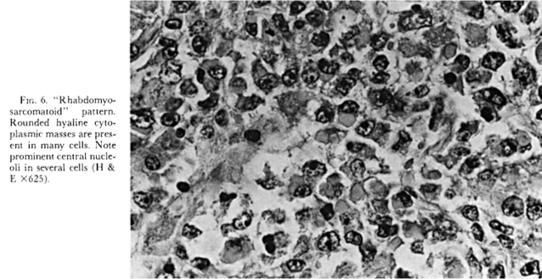
Malignant rhabdoid tumour
In the kidney, first described as a rhabdomyosarcomatoid
variant of Wilms tumors (Beckwith and Palmer, 1978):
Localization: ​
Paraspinal, perineal, abdominal and pelvic cavity or retroperitoneum.​
Extremities (thigh) and cutaneous lesions.​
Liver, thymus, genitourinary tracts, and TGI

Slide 24
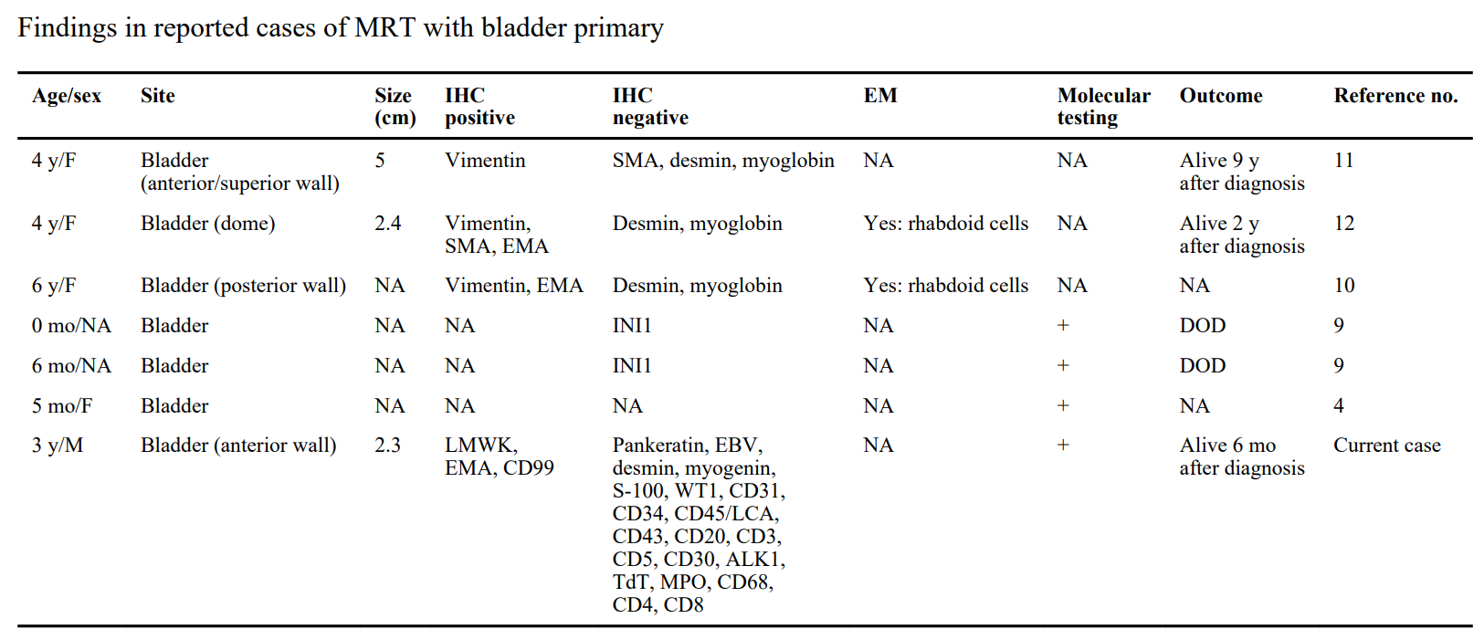
In the bladder:

Slide 25
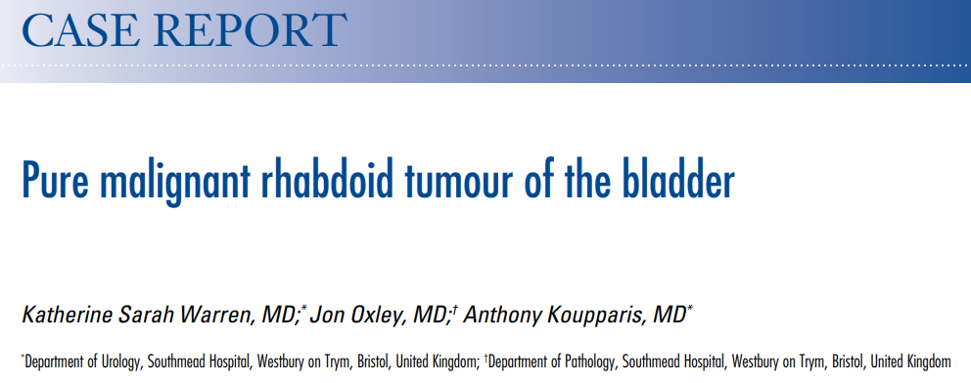
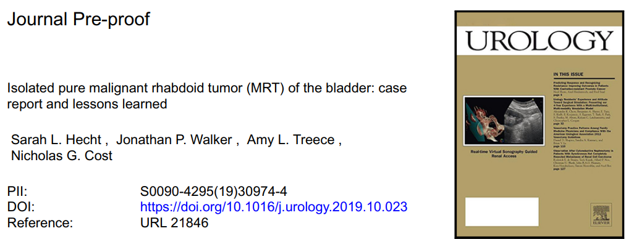
2014 17-year-old girl
Cystectomy (muscle fat invasion), radio, chemo
12 months free
2019
18 months-old girl
Partial cystectomy positive margin, radio, chemo
6 weeks free
2021
Age NA
Partial cystectomy, radio, chemo
Successfully treated

Slide 26
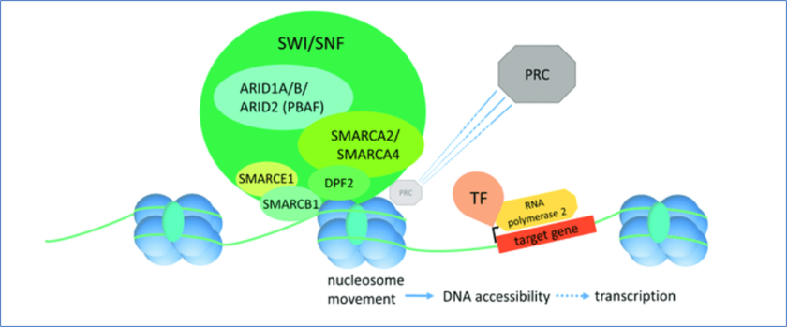
Proteína SMARCB1 - função
INI1 (INtegrase Interactor 1): gene 22q11.2, encodes a nuclear factor that integrates HIV viral RNA to active genes (1994).
SMARCB1: SWI/SNF related, Matrix associated, Actin dependent Regulator of Chromatin subfamily B member 1.
BAF47
hSNF5
Notes:
Approximately 20% of human cancers possess pathogenic variants in at least one SWI/SNF subunit.
Loss of SMARCB1 leads to activation of EZH2, a histone lysine methyl transferase and catalytic component of the PRC2 complex resulting in increased H3K27me3 marks associated with repression of polycomb gene targets. The Hippo signaling pathway is involved in the detrimental effects of SMARCB1 deficiency, and its main effector (YAP1) is overexpressed in AT/RT
SMARCB1 tumourigenesis follows the Knudson 2 hit hypothesis. One copy of the SMARCB1 gene is inactivated by a truncating variant, deletion, or other structural variation affecting the SMARCB1 locus, or rarely, missense or splicing alterations, whereas the second event is typically due to a chromosomal deletion or loss of heterozygosity

Slide 27
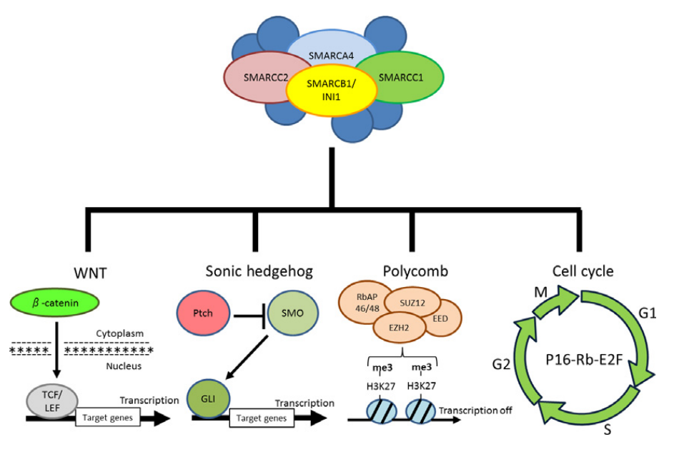
Etiology and Pathogenesis:
Homozygous inactivation (deletion) of the SMARCB1 gene 22q11.2
Inactivation of the SWI/SNF complex (epigenetic remodeller) leads to the silencing of a variety of tumour suppressor and differentiation genes and pathways
20% of solid tumors and hematologic malignancies are characterized by SWI/SNF complex deficiency.
The proliferation of stem cells not accompanied by cellular differentiation, and devoid of tumor suppression.
Notes:
22q11.23 – Braço longo do cromossomo 22, região 1, banda 1, subbanda 2

Slide 28
Etiology and Pathogenesis:
Increased risk
Rhabdoid Tumour Predisposition Syndrome 1: germline loss SMARCB1
First year of life, renal bilateral tumors
Association with Schwannomatosis (SMARCB1 + NF2)
Rhabdoid Tumour Predisposition Syndrome 2: germline loss SMARCA4 (BRG1)
Small-cell carcinoma of the ovary, hypercalcemic type
Notes:
Rhabdoid Tumour Predisposition Syndrome 1: germline loss SMARCB1 (CNS/ Kidney/Soft tissue)
MRT renal bilateral é patognomônico
Rhabdoid Tumour Predisposition Syndrome 2: germline loss SMARCA4 - ovarian small cell carcinoma of the ovary, hypercalcaemic type

Slide 29
Malignant rhabdoid tumour
IHC:
Keratins, EMA, CD99,
Synaptophysin, SMA, focal S100
INI1 loss
SALL4 and Glypican-3
SALL4 positive

Slide 30
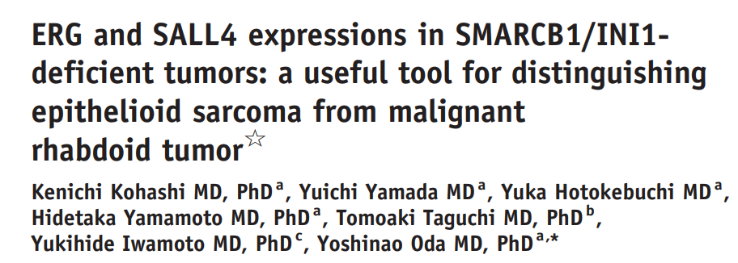
Frequency of ERG and SALL4 expressions in 80 SMARCB1/ INI1-deficient tumors

Slide 31
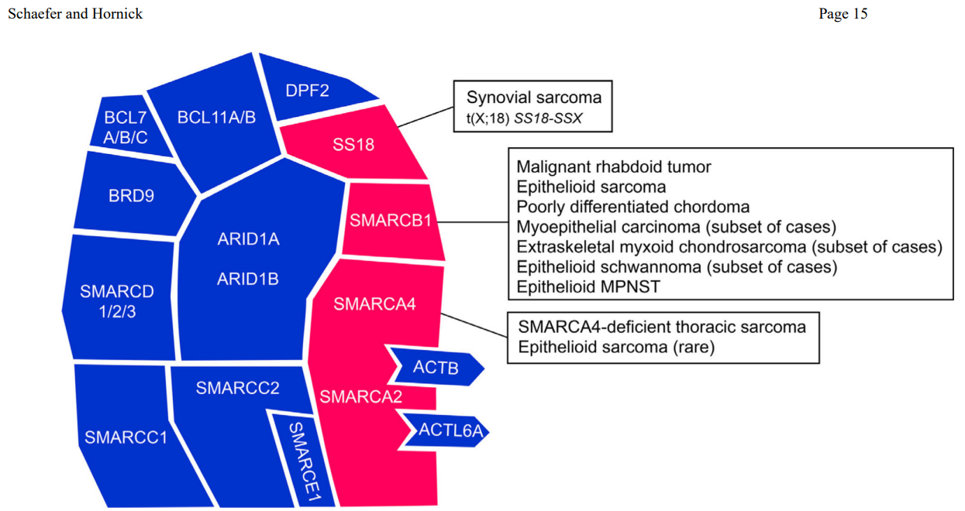

Slide 32
Take home messages
Perform INI1/SMARCB1 in primitive/undifferentiated tumors, especially if rhabdoid features
Usefulness of ERG and SALL4 in distinguishing between rhabdoid tumor and epithelioid sarcoma
Consider the use of molecular methods, such as DNA methylation profiling for sarcomas, especially small round and primitive patterns
Consider molecular genetic testing to confirm a suspected germline alteration.

Slide 33
References
WHO Classification of Tumours Editorial Board. Soft tissue and bone tumours [Internet]. Lyon (France): International Agency for Research on Cancer; 2020. (WHO classification of tumours series, 5th ed.; vol. 3). Available from: https://tumourclassification.iarc.who.int/chapters/33.
-Kalpana GV, Marmon S, Wang W, Crabtree GR, Goff SP. Binding and stimulation of HIV-1 integrase by a human homolog of yeast transcription factor SNF5. Science. 1994;266(5193):2002-2006. doi:10.1126/science.7801128
-Beckwith JB, Palmer NF. Histopathology and prognosis of Wilms tumors: results from the First National Wilms' Tumor Study. Cancer. 1978;41(5):1937-1948. doi:10.1002/1097-0142(197805)41:5<1937::aid-cncr2820410538>3.0.co;2-u
-Assadi, Akram MD*,†,‡; Alzubaidi, Ahmad MD*; Lesmana, Harry MD§,∥; Brennan, Rachel C. MD∥,¶; Saad, Ali MD#; Ortiz-Hernández, Vanessa MD*,†,‡; Gleason, Joseph M. MD*,†,‡. Pure Bladder Malignant Rhabdoid Tumor Successfully Treated With Partial Cystectomy, Radiation, and Chemotherapy: A Case Report and Review of the Literature. Journal of Pediatric Hematology/Oncology 43(8):p e1214-e1216, November 2021. | DOI: 10.1097/MPH.0000000000001963
-Savage N, Linn D, McDonough C, Donohoe JM, Franco A, Reuter V, Biddinger PW, Eaton KW, Biegel JA, Sharma S. Molecularly confirmed primary malignant rhabdoid tumor of the urinary bladder: implications of accurate diagnosis. Ann Diagn Pathol. 2012 Dec;16(6):504-7. doi: 10.1016/j.anndiagpath.2011.04.008. Epub 2011 Jul 19. PMID: 21775180; PMCID: PMC3448015.

Slide 34
References
-Warren KS, Oxley J, Koupparis A. Pure malignant rhabdoid tumour of the bladder. Can Urol Assoc J. 2014 Mar;8(3-4):E260-2. doi: 10.5489/cuaj.1633. PMID: 24839495; PMCID: PMC4001656.
-Hecht SL, Walker JP, Treece AL, Cost NG. Isolated Pure Malignant Rhabdoid Tumor (MRT) of the Bladder: Case Report and Lessons Learned. Urology. 2020;137:164-167. doi:10.1016/j.urology.2019.10.023
-Bourdeaut F, Fréneaux P, Thuille B, et al. Extra-renal non-cerebral rhabdoid tumours. Pediatr Blood Cancer. 2008;51(3):363-368. doi:10.1002/pbc.21632
-Hollmann TJ, Hornick JL. INI1-deficient tumors: diagnostic features and molecular genetics. Am J Surg Pathol. 2011;35(10):e47-e63. doi:10.1097/PAS.0b013e31822b325b
-Brennan B, Stiller C, Bourdeaut F. Extracranial rhabdoid tumours: what we have learned so far and future directions. Lancet Oncol. 2013;14(8):e329-e336. doi:10.1016/S1470-2045(13)70088-3

Slide 35
obrigado

